Slide 1
WP2 - Semantic Parsing and Generation of Documents and Documents Components
Claire GARDENT, Bikash GYAWALI, Anastasia SHIMORINA
CNRS / LORIA
Samuel CRUZ-LARA
University of Lorraine / LORIA

Slide 2


WP2
Goal: Provide tools and methods for:
    Converting texts to models and models to text
    Annotating text fragments with model elements
Tasks:
    T2.1 Data Collection
    T2.2 Semantic Parsing
    T2.3 Natural Language Generation
    T2.4 Definition of a common target semantic language
    T2.5 Development of a Semantic Parser and of a Natural Language Generator

Slide 3

Synchronising Text and Model
TEXT
SIDP Principle
GENERATION
Verification Authoring
Grammar
+
Lexicon
Model
Model
Description Logic
ANALYSIS Consistency checking
KB enrichment
MODEL

Slide 4
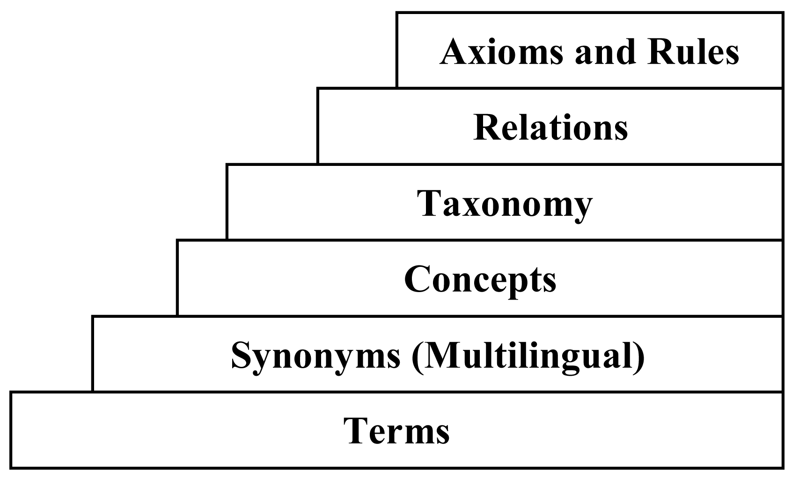
Related Work on Ontology Learning
Ontology Learning from Text
[Mädche and Staab 2000, Volker et al. 2007, Tablan et al. 2006, Zouaq and Nkambou 2008]
  Restricted expressivity. Not applied to sentences (complex axioms).
  Limited to : definition of new classes, creation of hierarchies between classes, definition of object and data-type properties, creation of instances, and setting of property values for instances

Slide 5
Related Work on Semantic Parsing
  Deep parsing
  [Currant et al. 2007, McCartney and Manning 2007 ]
  First Order Logic Representations close to initial text. Trained on newspaper text (Penn Tree Bank).
  ==> Not easily adaptable to Description Logic and SIDP text.
  Domain Specific Semantic Parsing
  [Ge and Mooney 2009,Wong and Mooney 2007]
  ==> Require parallel text-data training corpus.
  Open Domain Semantic parsing
  [Kwiatkowski et al 2010, Bordes et al. 2012, Kwiatkowski et al 2013, Berant et al., 2013, Bordes et al. 2014, Wang et al. 2015]
  ==> Restricted to questions. Require parallel question-answer training corpus.

Slide 6
Related Work on Text Generation
  Symbolic Approaches
  [Dimitrios et al. 2007, Androtsopoulos et al. 2013, Power et al. 2010, Bontcheva et al. 2004 ]
  Heavily dependent on hand-written modules.
  Machine Learning Approaches
  [Wong et al. 2007, Belz 2008, Angeli et al. 2010, Chen et al. 2008, Konstas and Lapata 2012a and 2012b]
  Require parallel data-text training corpus.
  Pattern-Based
  [Duma et al. 2010, Blake et al. 2013, Schilder et al. 2013]
  Require large quantity of parallel or comparable text-data training corpus. Limited Semantic Variability (set of RDF triples).

Slide 7
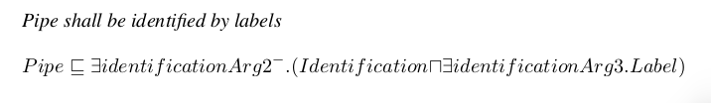
Contributions
Reversible Processing: Text <--> Model
Analysis: SIDP Rule → Description Logic
Generation: Description Logic → SIDP Rule
Verification by generation
Semantic Parsing of Complex Axioms
Executable Semantic Parsing on DL KBs
The output of semantic parsing is used to update a Description logic Knowledge Base and check the consistency of SIDPs (system installation design principle)
Genericity
No training corpus required.
Adaptation to a new domain through grammar adaptation, extension or induction

Slide 8
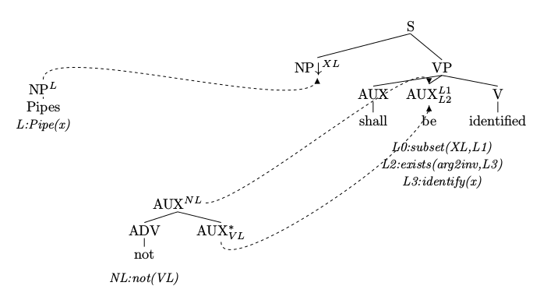
Grammar-Based Parsing and Generation

Slide 9
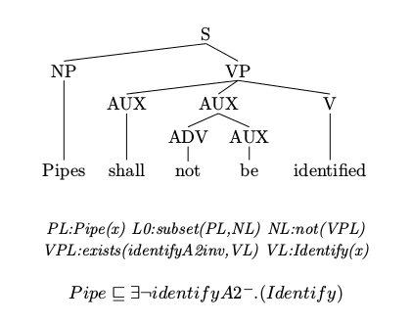
Grammar-Based Parsing and Generation

Slide 10
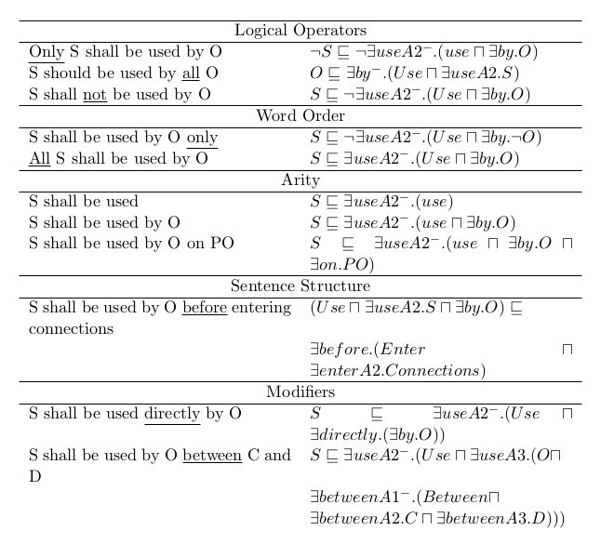
Semantic Variations

Slide 11
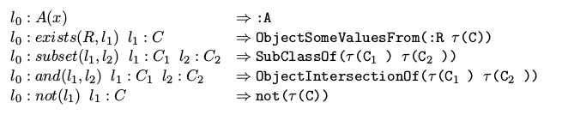
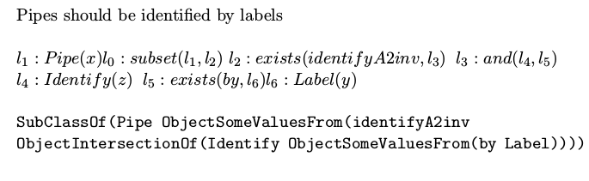
Updating the Model and Checking Consistency
The Semantic Representations output by the parser are converted to Description Logic
E.g.,
The formula is added to the AIRBUS KB and Hermit is used to check for consistency

Slide 12
Experimental Setup and Results for Parsing
Grammar: 52 trees
Lexicon: 10781 lexical entries
Parsing algorithm: CKY + Robustness mechanism to skip unknown words
Input: 991 System Installation Design Principles
 | Complete Parse | Partial Parse | Failure
Simple SIDP | 132 | 329 | 24
Complex SIDP | 0 | 496 | 10
All SIDP | 132 (13%) | 825 (83%) | 34 (3%)

Slide 13
Updating the Model using Parsing Results (Complete Parses)
Nb. of new Concepts | 184
Nb. of Existing Concepts | 30
Nb. of New Properties | 62
Nb. of SIDP Axioms (from Parsing) | 132
Nb of Invalid Axioms | 0
Nb. of Redundant Axioms | 2
Total Nb. Of Added Elements | 376
Nb. of Axioms in Initial KB | 12469
Nb. of Axioms in Enriched KB | 13029
CONCEPTS
PROPERTIES
SIDP AXIOMS
ALL

Slide 14
Updating the Model using Parsing Results (All Parses)
Nb. of new Concepts | 667
Nb. of Existing Concepts | 79
Nb. of New Properties | 98
Nb. of SIDP Axioms (from Parsing) | 957
Nb of Invalid Axioms | 61
Nb. of Redundant Axioms | 125
Nb. of Inconsistent Axioms | 20
Nb. of added SIDP Axioms | 749
Total Nb. Of Added Elements | 1514
Nb. of Axioms in Initial KB | 12469
Nb. of Axioms in Enriched KB | 14650
CONCEPTS
PROPERTIES
SIDP AXIOMS
ALL

Slide 15
Generation Results
Grammar: 52 trees
Lexicon: 10781 lexical entries
Generation algorithm: Tabular + Polarity Filtering
Input: 957 Description Logic Axioms derived from the AIRBUS System Installation Design Principles
 | Success | Failure
Simple SIDP | 448 | 13
Complex SIDP | 470 | 26
All SIDP | 918 (96%) | 39 (4%)

Slide 16

Verifying Parsing Results Using Generation
BLEU | < 0.33 | > 0.32 and < 0.67 | > 0.66
Complete Parses (S) | 1 | 0 | 131 (14%)
Complete Parses (C)
Partial (Simple) | 143 | 117 | 69
Partial (Complex) | 396 | 91 | 9
All Parses | 540 (56%) | 208 (22%) | 209 (22%)
Regenerating from the DL formula derived through parsing from an
SIDP:
  Produces a sentence identical to the input SIDP for complete parses
  Produces a sentence highly similar to the input SIDP in 44% of
  of the cases for partial parses

Slide 17
Perspectives and Future Work
Improve lexicon construction using chunking
Improve coverage on complex sentences including conditions
Querying the KB (support for AIRBUS engineers)
Improve robustness and genericity (experiment with deep learning
approaches using data expansion techniques and sequence to
sequence models)

